Slide 1
CSE 2451 GNU Project Debugger (GDB)
Tong Liang

Slide 2
What’s GDB
The GNU Project Debugger, allow you to see what’s going on inside another program while it executes, help you to catch bugs:
Start your program, specifying anything that might affect its behavior.
Make your program stop on specified conditions
Examine what has happened, when your program has stopped
Change things in your program, so you can experiment with correcting the effects of one bug and go on to learn about another

Slide 3
GDB
Compile the target source code with –g flag option of gcc
gcc “-g” generates debug symbolic information to be used by GDB
After you generated the executable program file, start GBD via:
gdb ”-tui” (terminal user interface) option enables a UI showing the source code
gcc –g –Wall src.c –o prog –std=c99
gdb –tui ./prog
Notes:
https://www.youtube.com/watch?v=mm0b_H0KIRw

Slide 4
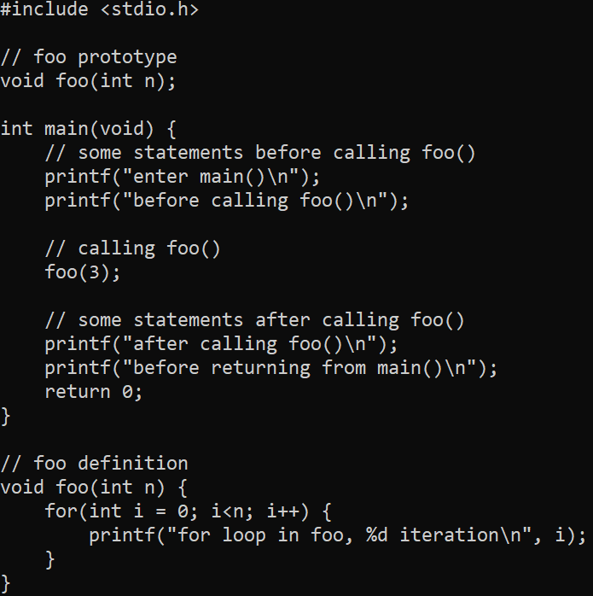
GDB – example
src.c
Source code on the right
Step 1: compile with –g option
E.g., gcc –Wall –g src.c –o prog –std=c99
if gcc complains due to some syntax errors in your source code, you won’t need gdb to find bugs, correct errors in source code according to gcc error message
Step 2: start gdb with gui
E.g., gdb –tui ./prog
In the above example, prog is the executable file’s name

Slide 5
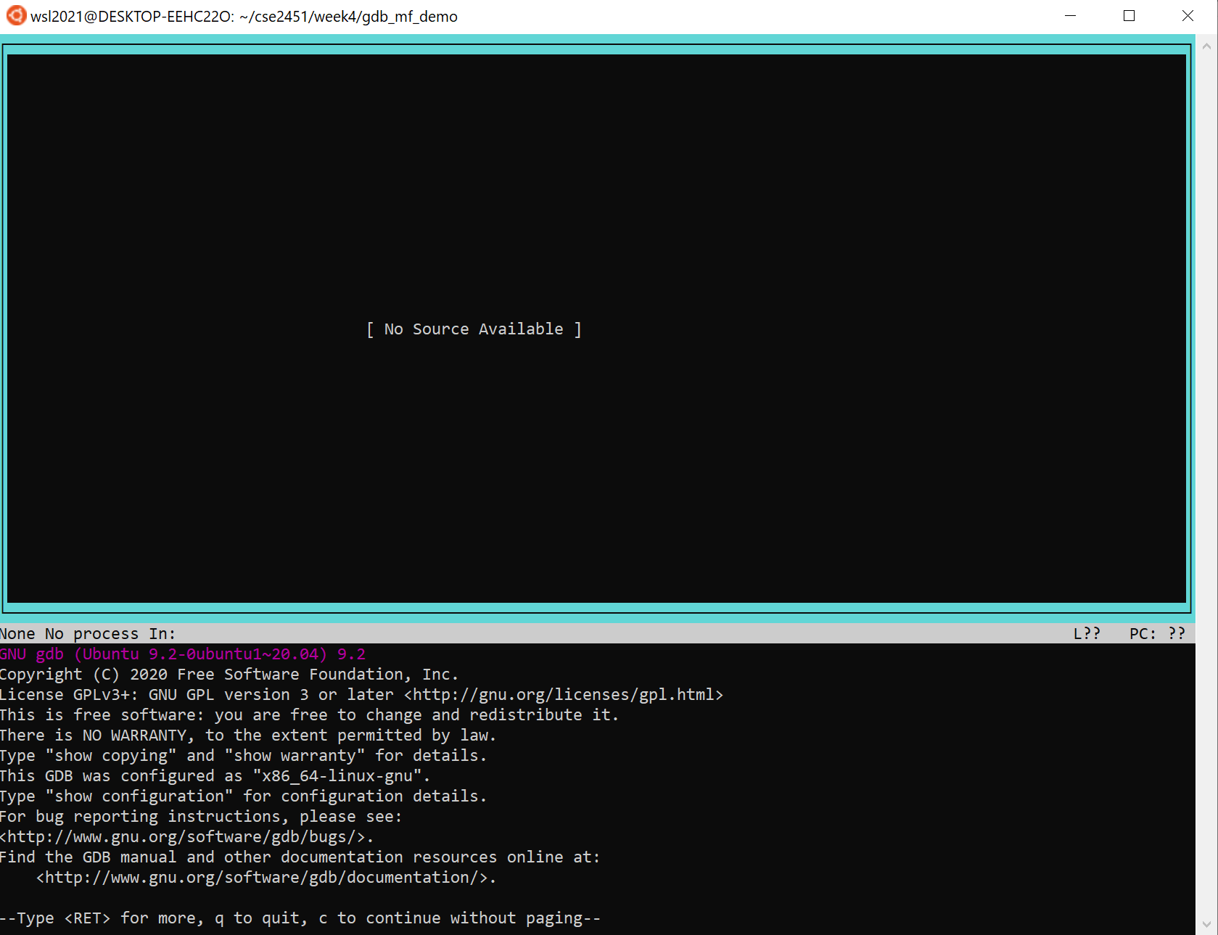
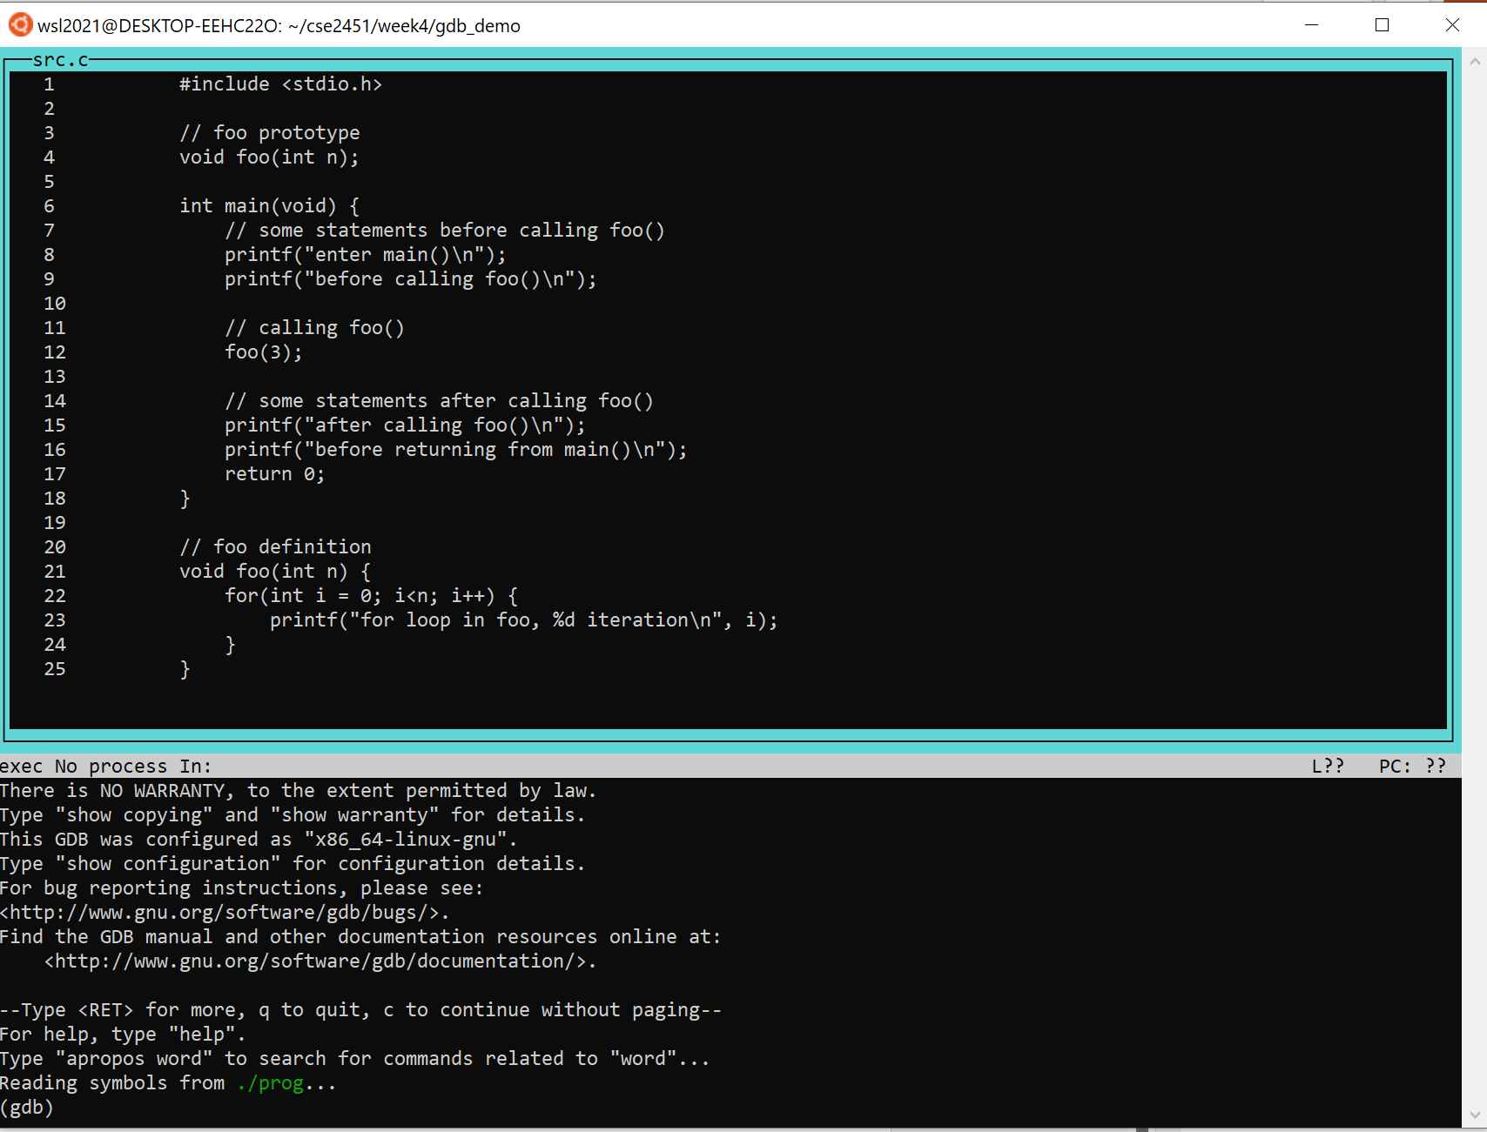
GDB – example
Step 2: start gdb with terminal UI
When gdb with tui started, hit <enter> to make the source code visible

Slide 6
GDB
Set up breakpoints (pause execution when we reach the line with a breakpoint)
break <line_number>
line number of the source file
break <filename>:<line_number>
multi-file program
break <function_name>
everytime this function is called, pause execution
Replace the above commands’ “break” with “b” also works
Run program (usually after you’ve set up the breakpoints)
run
the execution of your program will pause at the first breakpoint it encounters

Slide 7
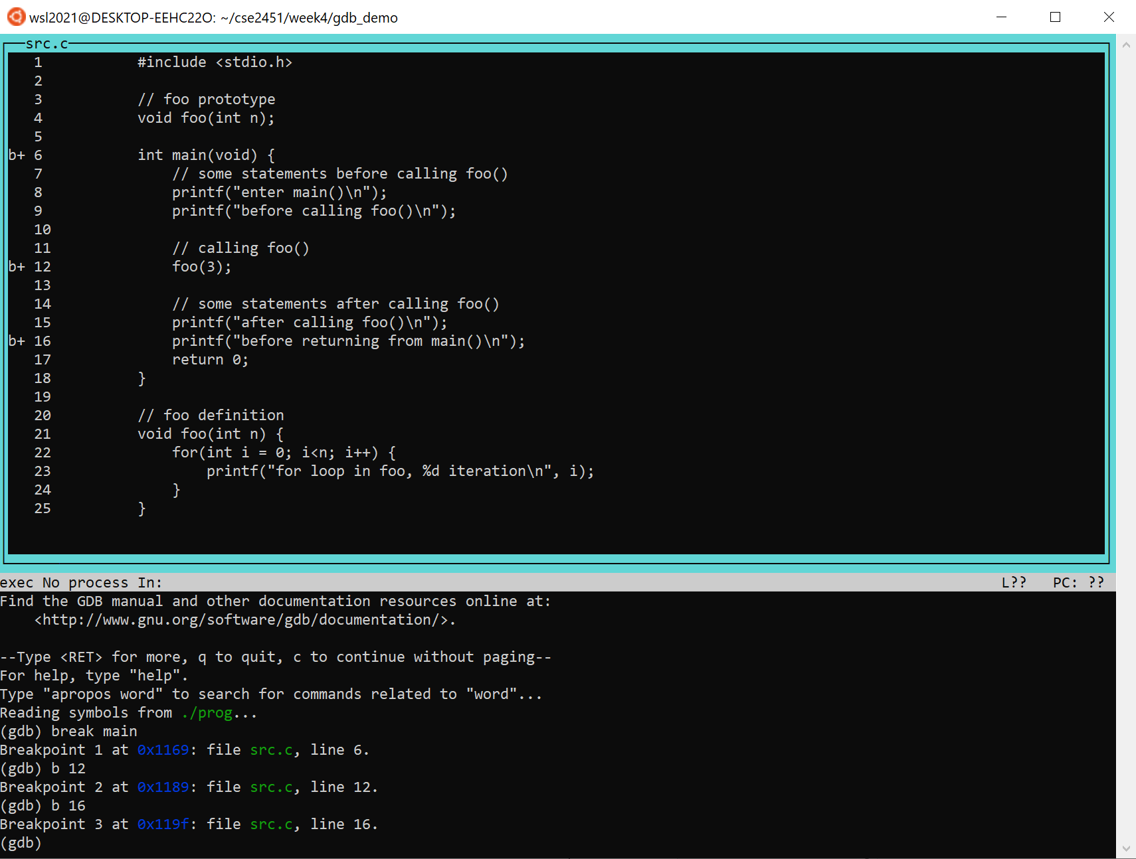
GDB – example
Step 3: setup breakpoints
break main
break before entering main()
b 12
break before calling foo()
b 16
break before printing “before returning from main()\n”

Slide 8
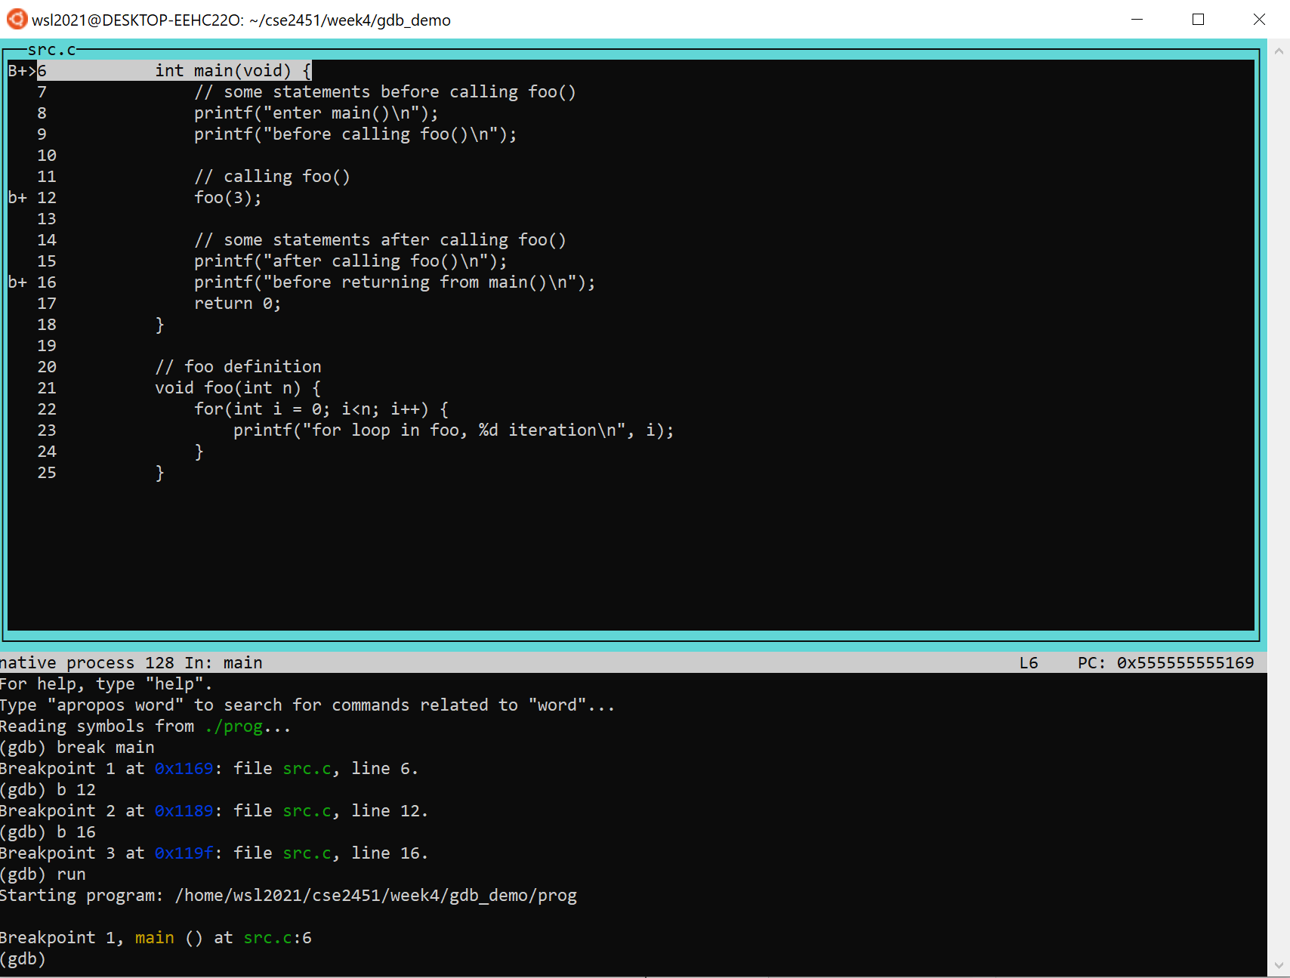
GDB – example
Step 4: run the program
run
The execution is paused at the 1st breakpoint we set in our last step

Slide 9
GDB
Resume execution of the program after breakpoint
continue
you can use “c” instead of “continue”
this will let the execution continue until it reaches the next breakpoint or the end of the program
Execute the program step by step
next
next treat function call as one step
you can use “n” instead of “next”
Step
step into a function call
you can use “s” instead of “step”

Slide 10
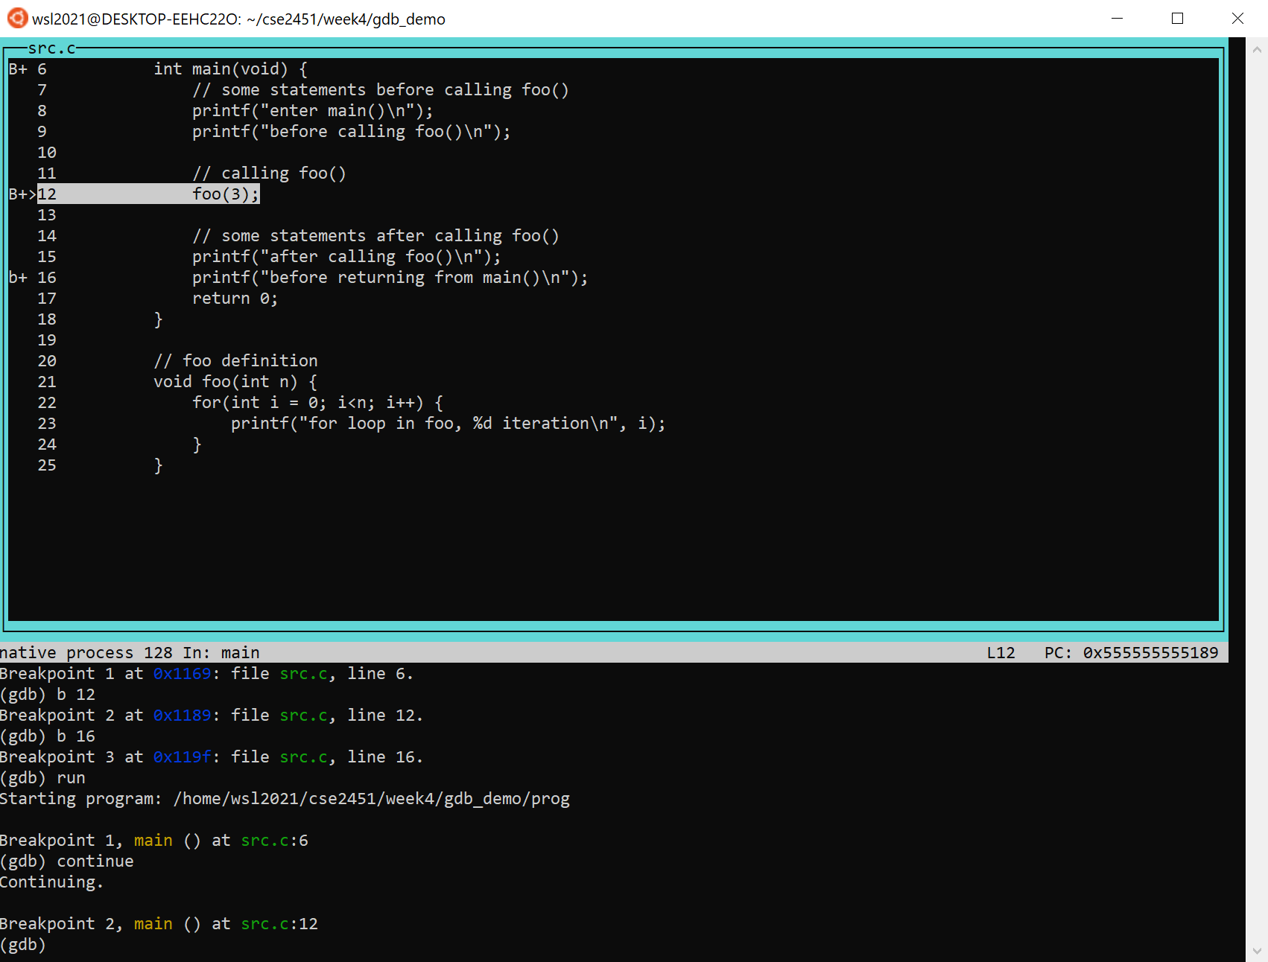
GDB – example
Step 5: resume execution
continue
The execution resumed from our 1st breakpoint, and paused again to our 2nd breakpoint

Slide 11
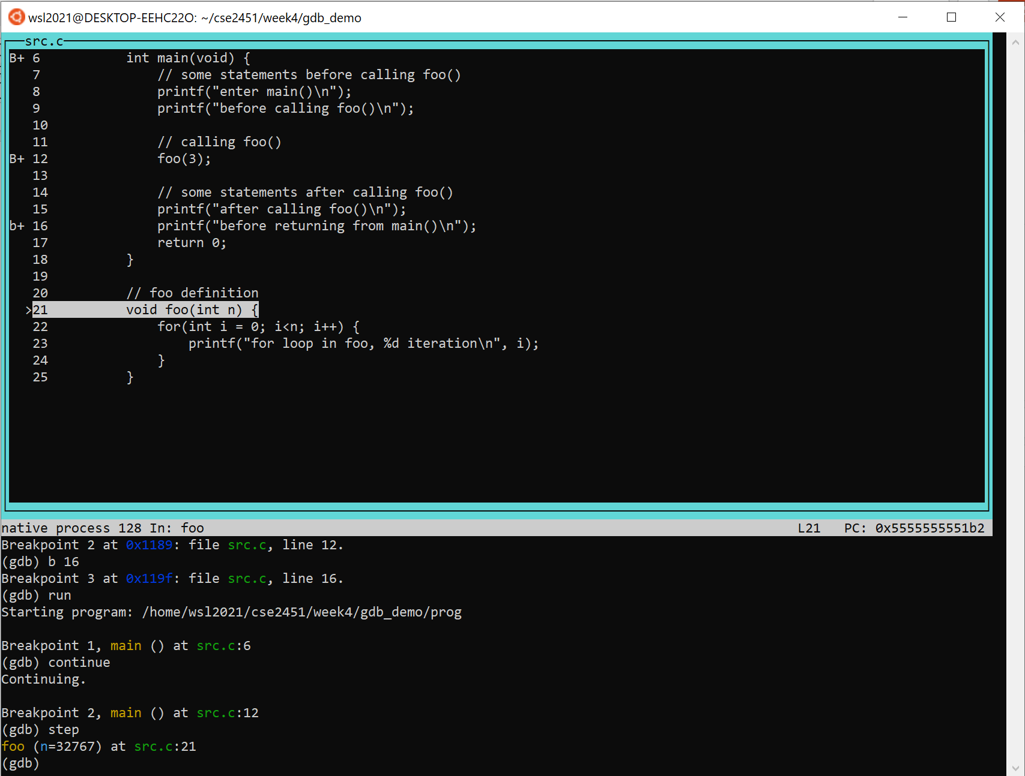
GDB – example
Step 6: step into a function call
step
the execution stepped into finer details, as the highlight goes into the function definition

Slide 12
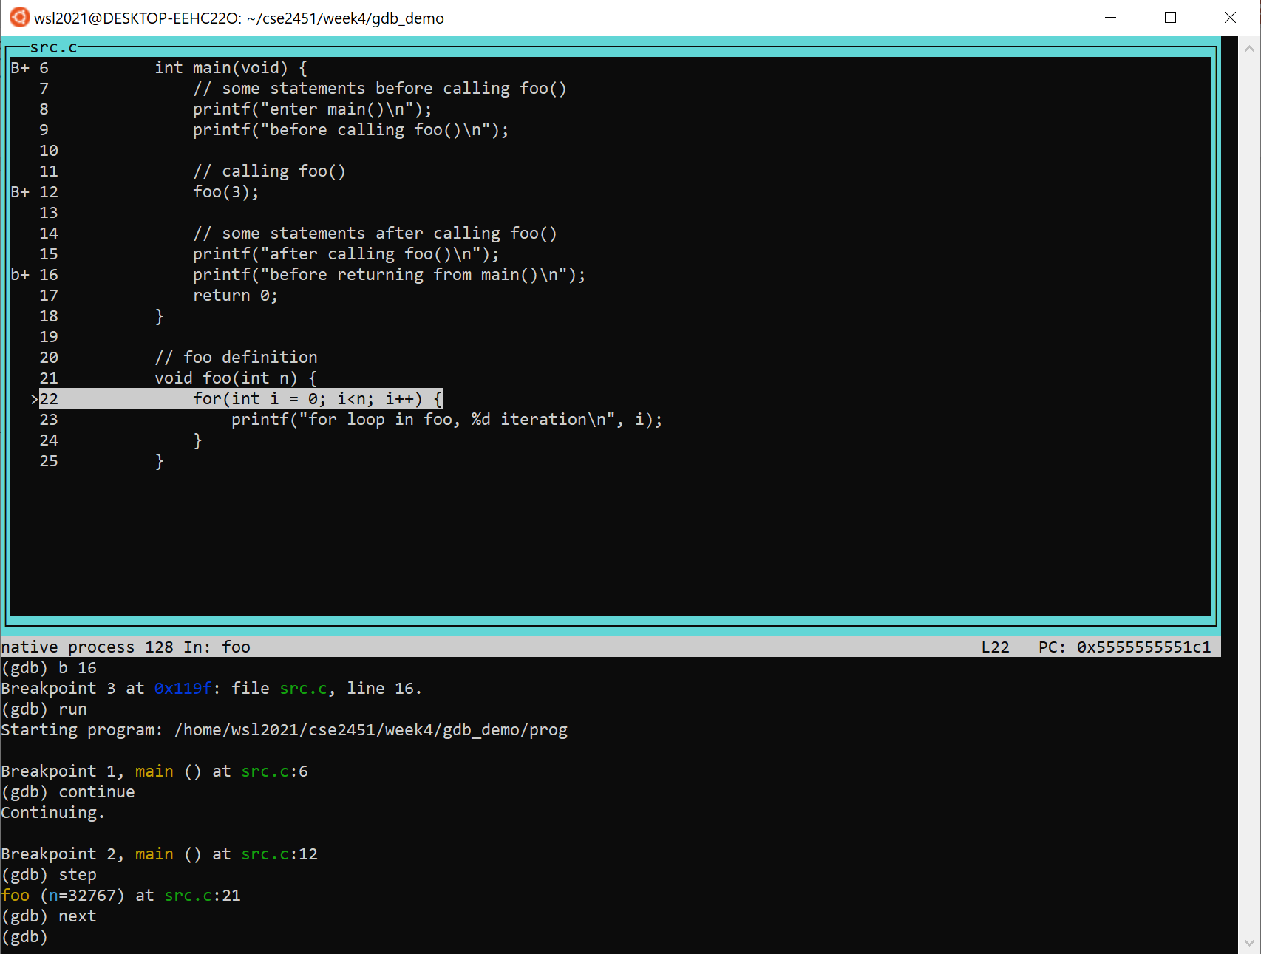
GDB – example
Step 7: execute step by step
next
Execution stops at for statement

Slide 13
GDB
Print expression
print <expression>
Expression can include variable identifiers
Expression can include operators to variables, e.g., & (fetch address of the variable)
Expression can include calls to functions in the program being debugged
Auto displaying expression
display <expression> → report a display number
Specifies the expression that will be automatically evaluated and displayed after each step
undisplay <display_number> → remove the expression from auto display
delete display <display_number> → remove the expression from auto display

Slide 14
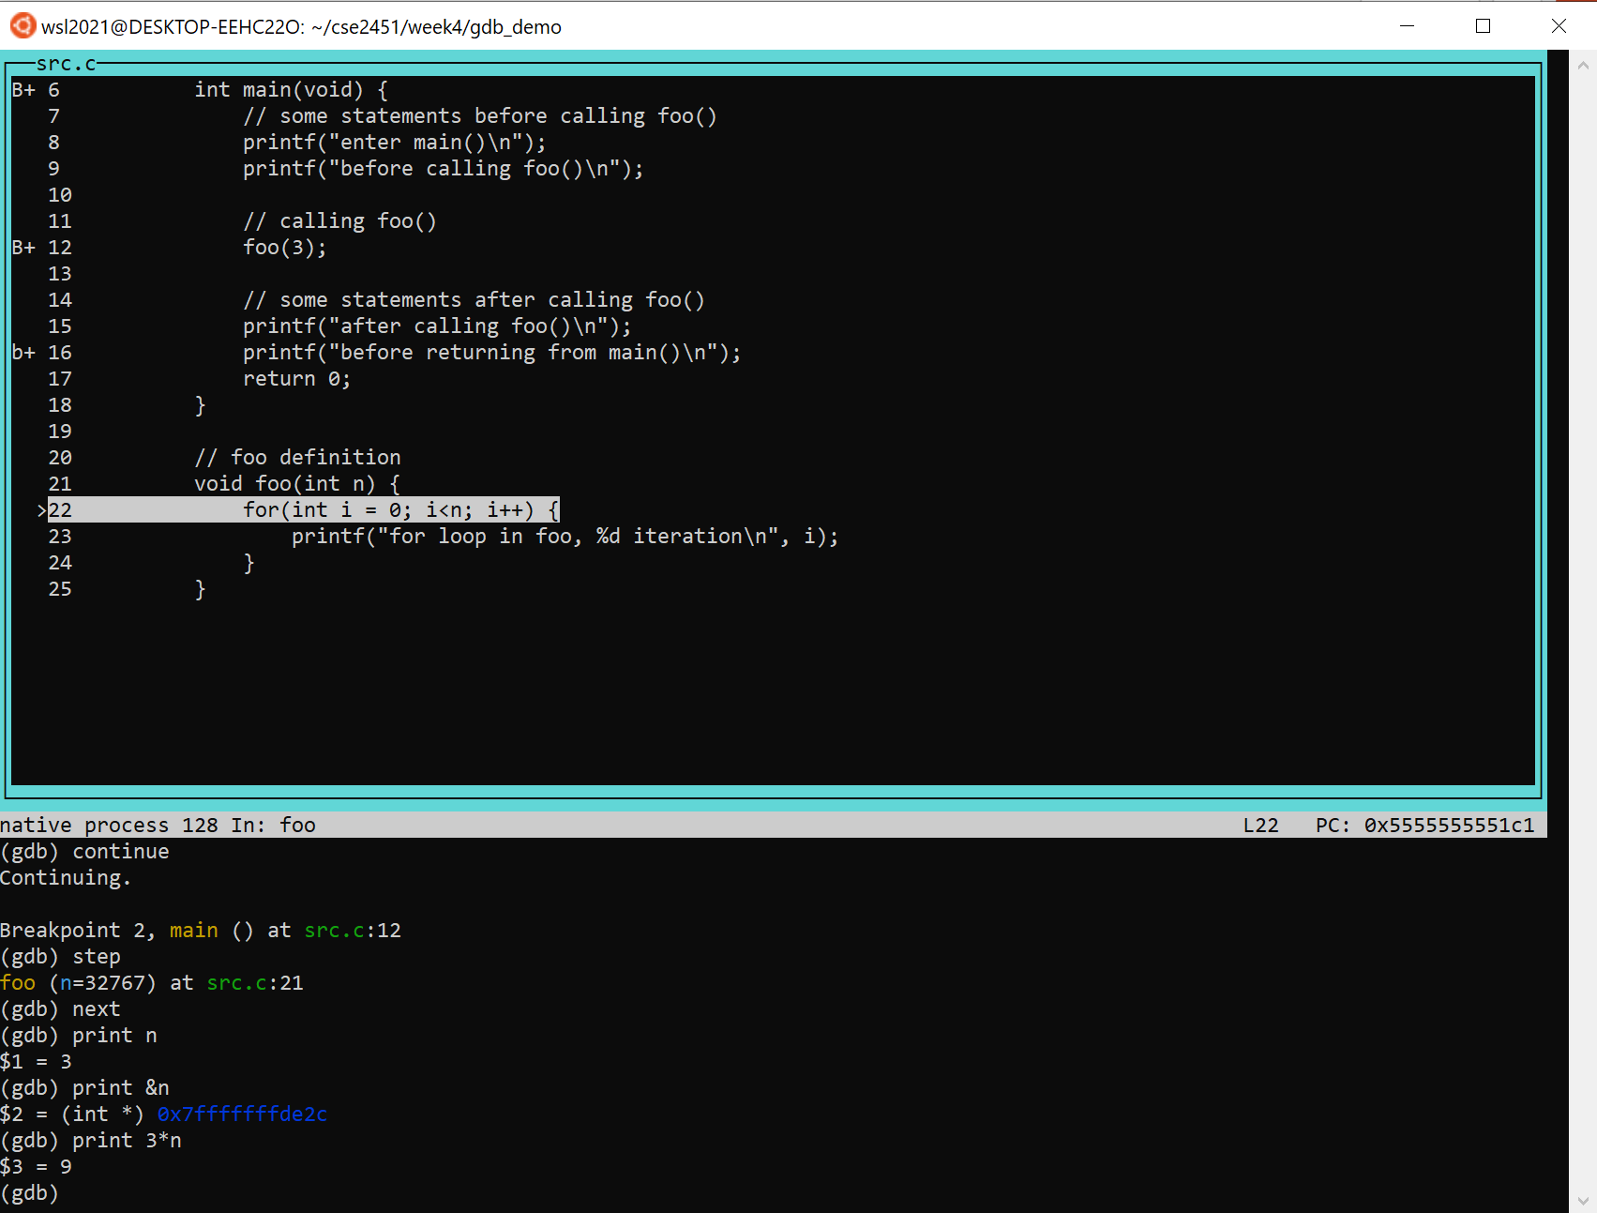
GDB - example
Step 8: print expression value
print n
print &n
print 3*n

Slide 15
GDB
Set up watchpoints (execution pauses when variable value changes)
watch <variable> → return a watchpoint number
watchpoint of a variable functions like a conditional breakpoint, i.e., every time the associated variable’s value changed, the program execution is paused
delete <watchpoint_number> → remove the watchpoint number
You need to remove a watchpoint inside a function before stepping outside the function
watch vs display
Watch stops execution of the program on the condition that the associated variable’s value changed
display shows the value of the associated expression every time the execution stops

Slide 16
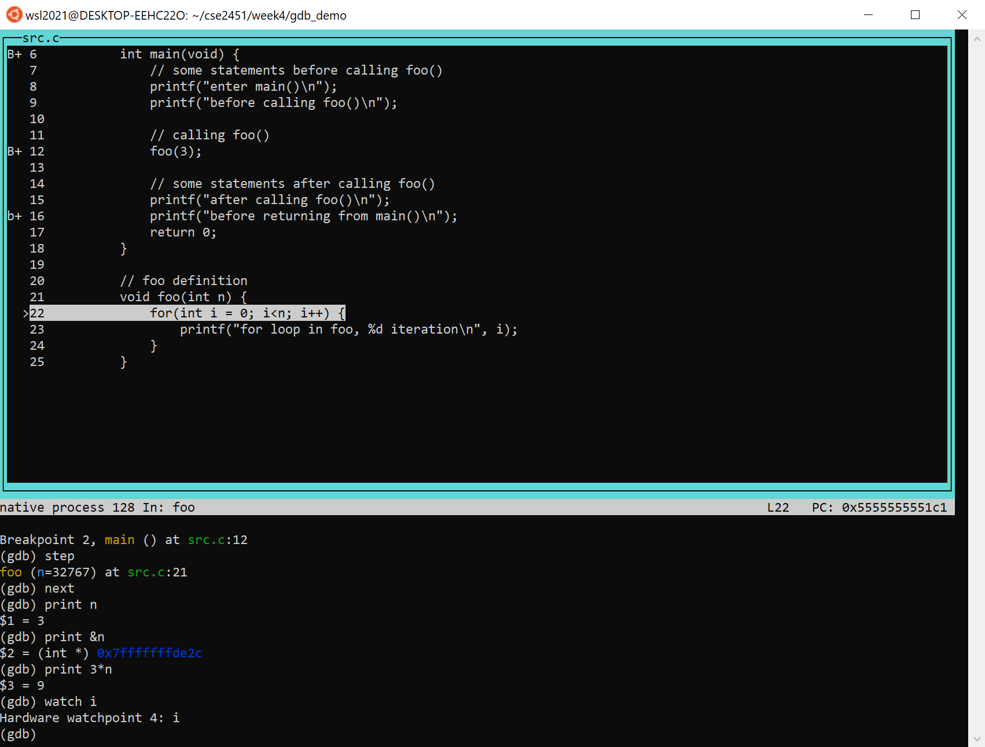
GDB – example
Step 9: setup a watchpoint for iteration variable i of for-loop
watch i
You can setup a watchpoint for a variable before the variable is initialized
Watchpoint number 4 for variable i

Slide 17
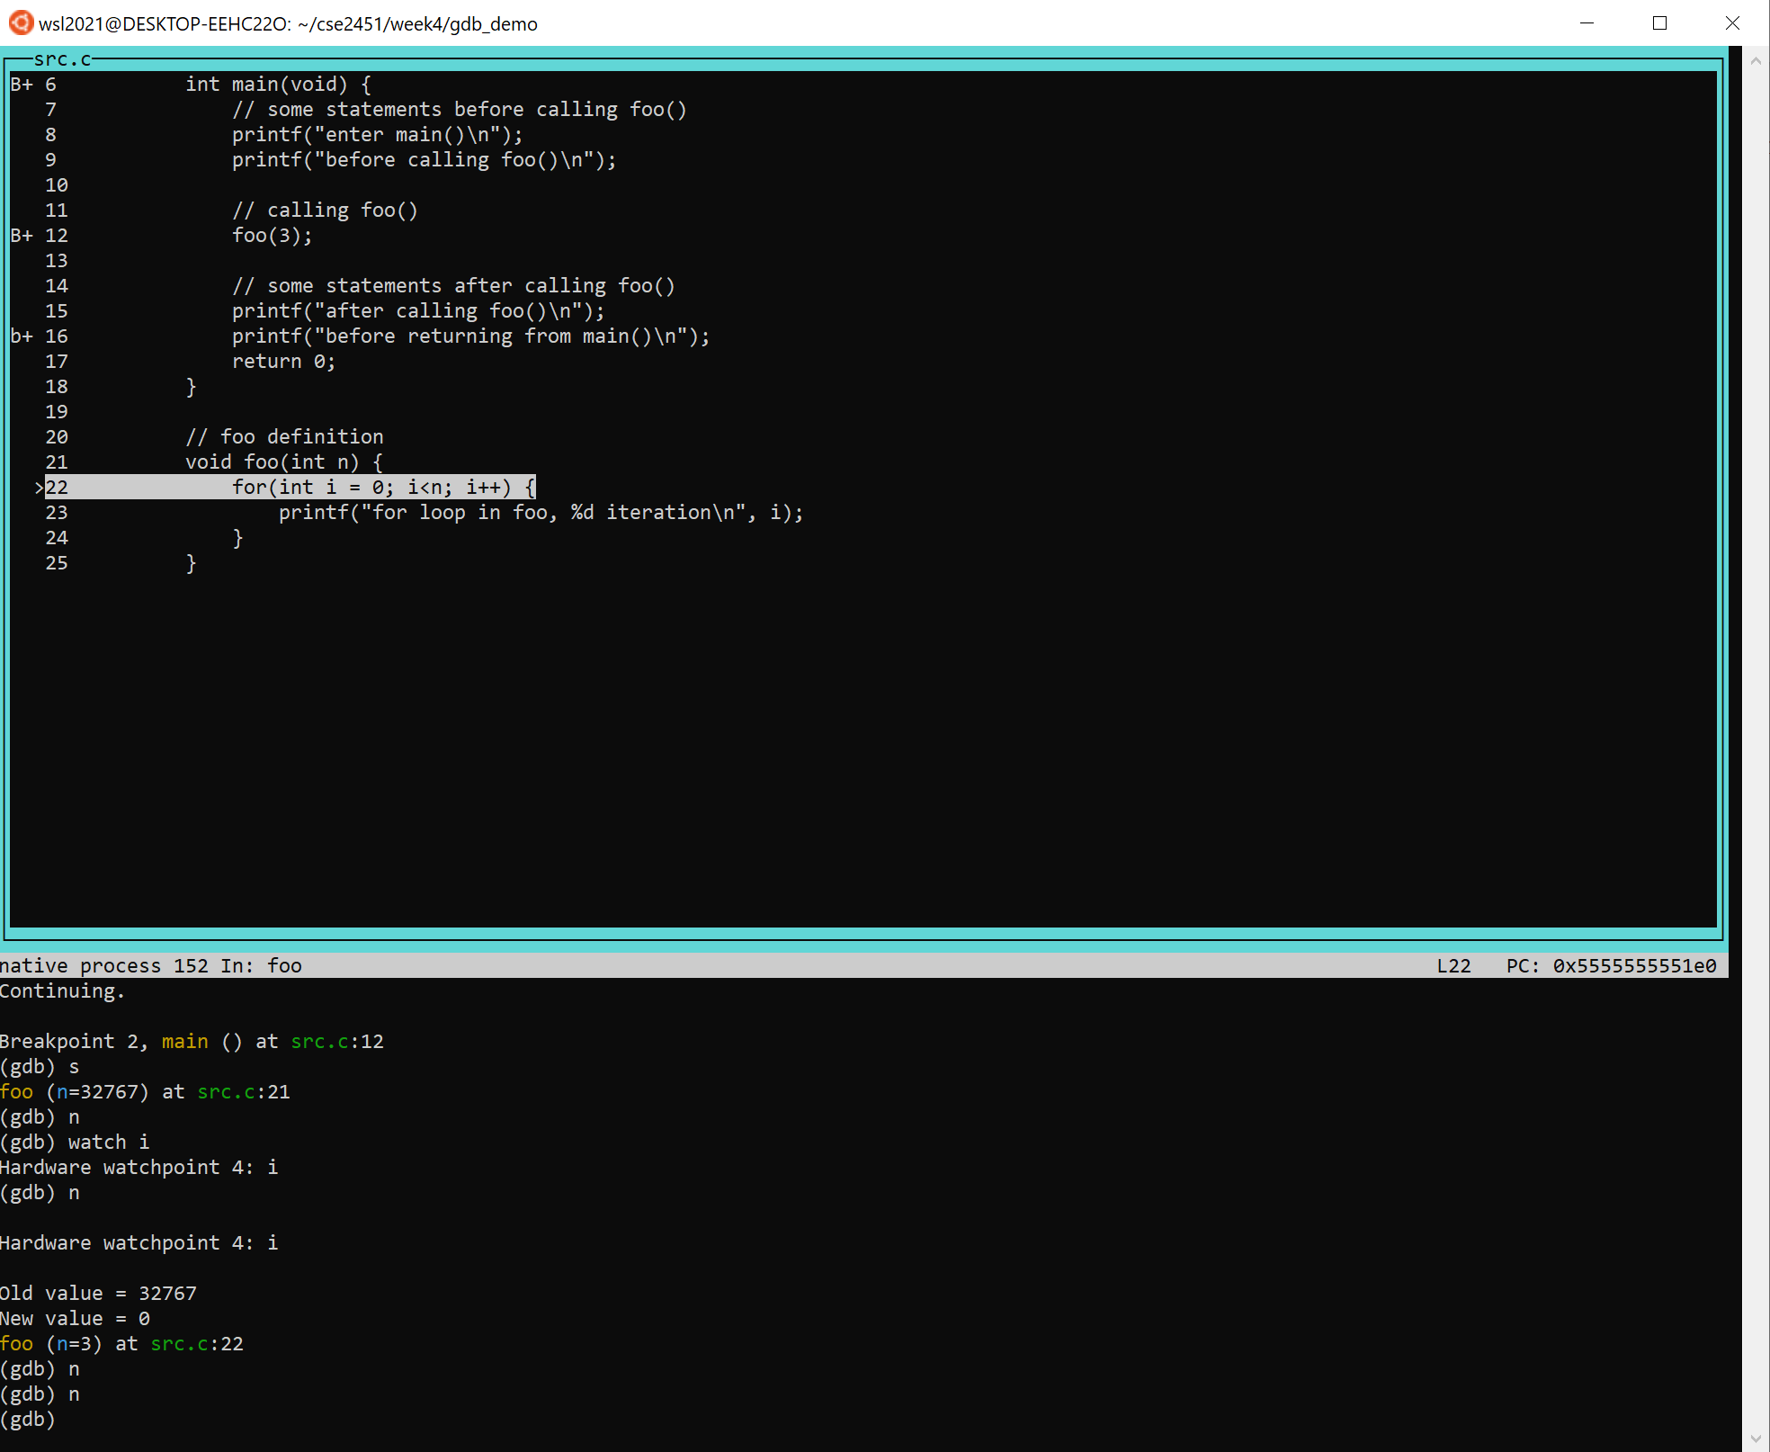
GDB – example
Step 10: stepping through the rest of the foo() function call
n // next
n
n
run 3 next

Slide 18
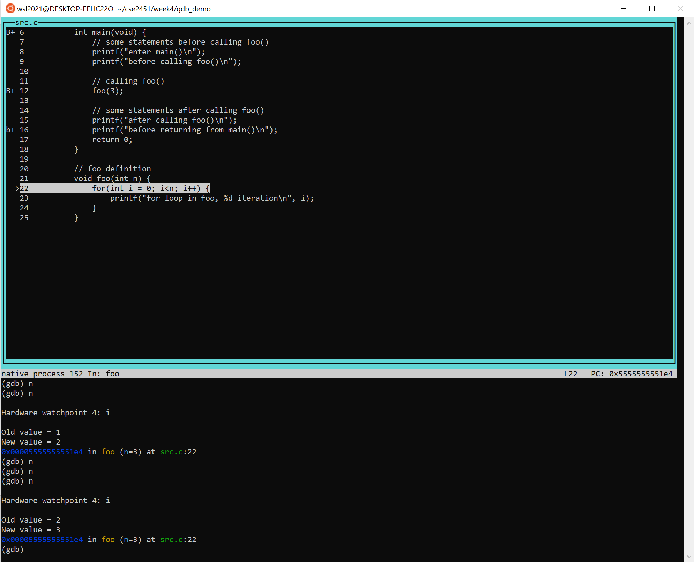
GDB – example
Step 10: stepping through the rest of the foo() function call
n // next
n
n
n
n
n
n
run 7 next, i’s value is 3 (end of for loop)

Slide 19
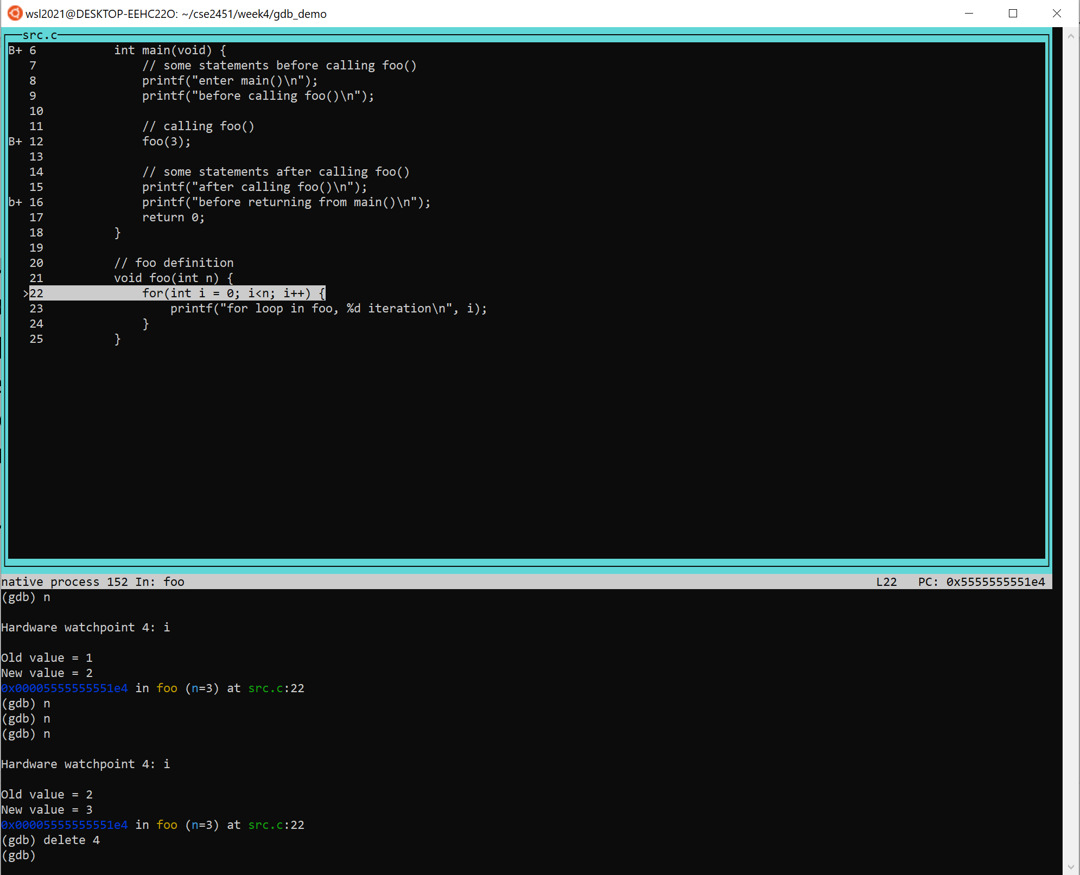
GDB – example
Step 10: stepping through the rest of the foo() function call
Inorder to step out of the foo() function, we need to remove the watchpoint set on the local variable i inside foo() function scope
Watchpoint number for variable i is 4
delete 4

Slide 20
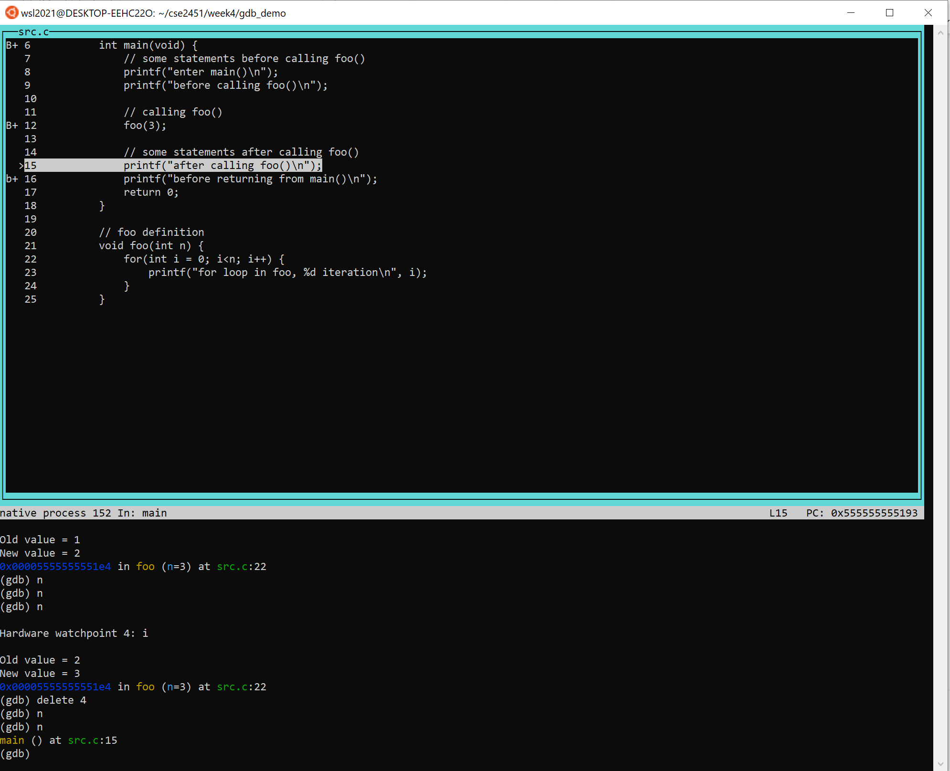
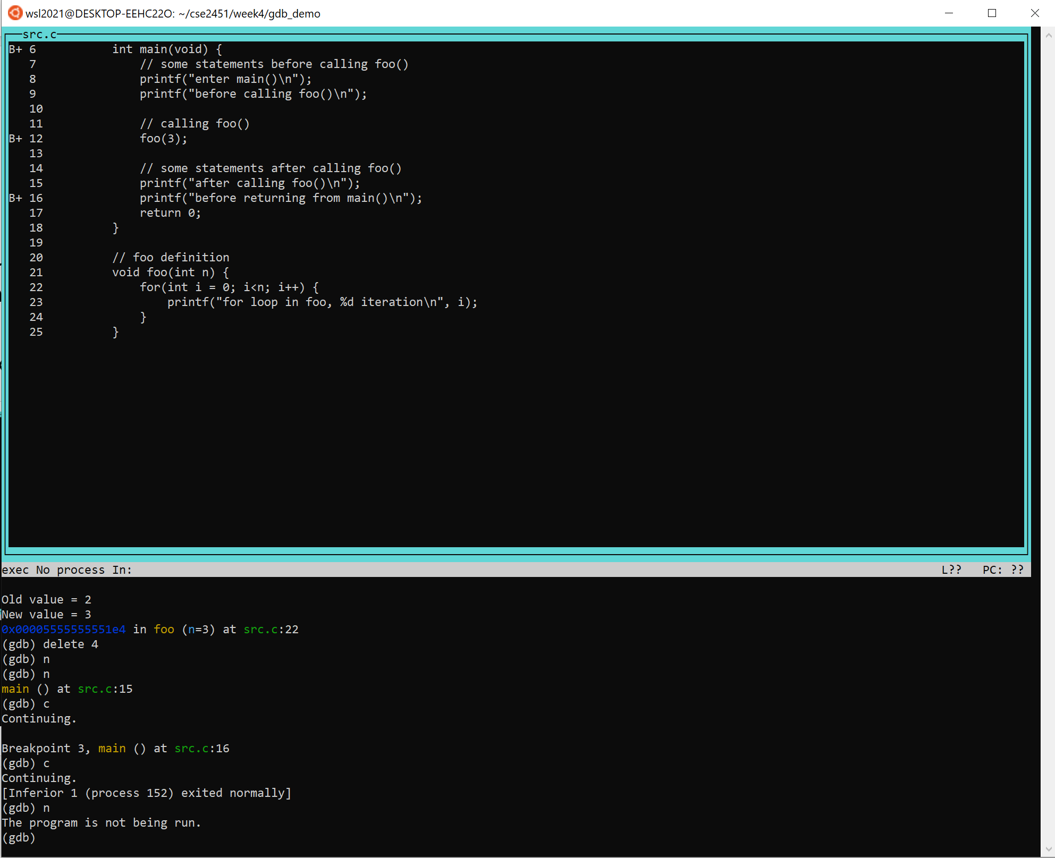
GDB - example
Step 11: step out of foo() function call with next
next // cond-expression i<n
next // return from foo() to main()
At this point, keep using next or continue will lead execution to the end of this program

Slide 21
GDB - example
Step 11: step out of foo() function call with next
next // cond-expression i<n
next // return from foo() to main()
At this point, keep using next or continue will lead execution to the end of this program

Slide 22
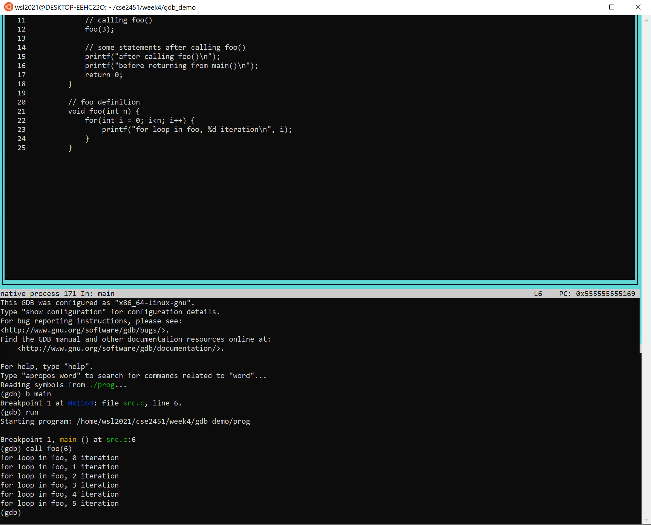
GDB
Call functions with your input arguments
call <function_name>(<args…>)
Similar with print, the function needs to be in the program being debugged by GDB
Quit GDB with either of the following command
quit
q

Slide 23
Using GNU Debugger
Compile your code with debugging symbols enabled:
gcc -g -o myprogram mycode.c
Run gdb with terminal UI
gdb -tui ./myprogram
Set up breakpoints (stop when we reach this line)
break <line_number>
break <filename>:<line_number>
break <function_name>
Run program
run
Resume program after breakpoint
continue
Go step by step
next
step
Display expression
print <expression>
display < expression >
Call functions
call <function_name>(<args…>)
Set up watchpoints (stop when variable changes)
watch <variable>
Remove auto display or watchpoints
delete <watchpoint_number>
delete display <display_number>

